Slide 1
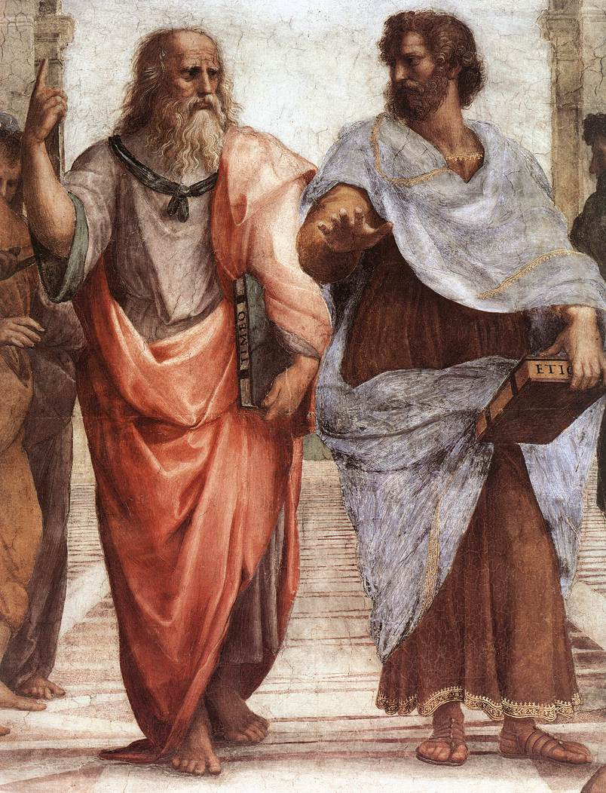
Classical Greek Philosophy

Slide 2
Socrates
Simple man
Stonemason
Shrewish wife
Loyal service in the war
Incredible concentration
Wisest man in Athens (oracle)
Gad fly (Dialectics/Socratic method)
“The unexamined life is not worth living.”

Slide 3
Socrates
Convicted of “corrupting the youth”
Described as “the best and wisest” and “most noble” man

Slide 4
Plato
Student of Socrates
The Academy
Mathematics
What is the real nature of things?

Slide 5
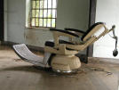
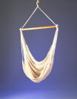
What makes this a Chair?
Chairness

Slide 6
Plato
The Republic
Ideal society
Rule by the philosophers
The Allegory of the Cave

Slide 7
Plato
Superiority of the intellectual life
Platonic love
Devalued the physical
Creation by the Demiurge
Shaping imperfect matter into the perfect Form
Ethics Find the Form in all things

Slide 8
Aristotle
Taught by Plato
Lyceum
Natural sciences
Truth is best understood from observation of living things
Capable in many areas
Forms can be understood from the physical as well as from the purely intellectual

Slide 9
Aristotle
Aristotelian Scientific Method
Used for 2000 years
Basic assumptions based on reasoning
Deductive method
Observations used to confirm the assumptions
Example: Elements of earth (4) and heavens
Example: Qualities of things
Did not employ experimentation
Disturbs nature

Slide 10
Aristotle
Four Causal Questions (Physics)
Material Question (What is it made of?)
Efficient Question (What caused it?)
Formal Question (What is its Form or essence?)
Final Question (What is its final end or purpose?)

Slide 11
Aristotle
Example: A Mouse
Material: molecules
Efficient: birth
Formal: dna (information)
Final: fulfill its purpose as a creature of God

Slide 12
Aristotle
Motion
Bodies move to achieve their stable ("natural") position
Heavier bodies fall faster
Poetics
Rhetoric
Ethos = power of persuasion created by the character of the speaker (Gettysburg Address)
Pathos = power of persuastion created by the passion of the speaker (I Have a Dream speech)
Ethics Act to avoid extremes

Slide 13
Thank You

Slide 14
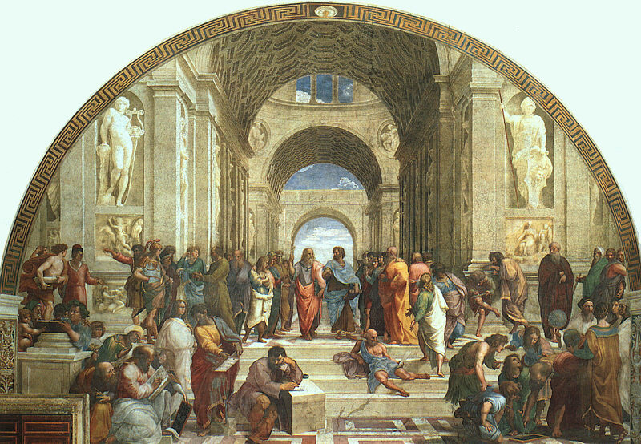
Classical Greek Philosophy
Alexander
Xenophon
Eschines
Socrates
Raphael
Zeno
Alcibiades
Plato
Aristotle
Epicurus
Parmenides
Zoroaster
Averroes
Hypatia
Diogenes
Ptolemy
Anaxagoras
Heraclitus
Anaximander
Pythagoras
Euclid

Slide 15
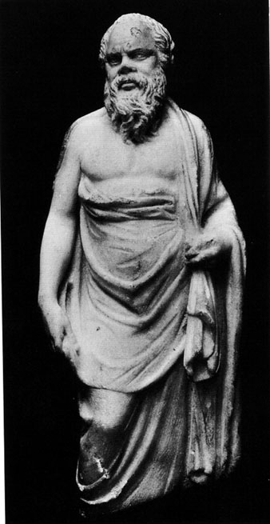
Socrates 470-399 BC
Divided philosophy into 2 groups
Pre-Socratics
After were based upon his ethics and methods
Philosophers versus Sophists
Believed in a single, all powerful God
Used dialectics (Socratic Method) to find ultimate truth

Slide 16
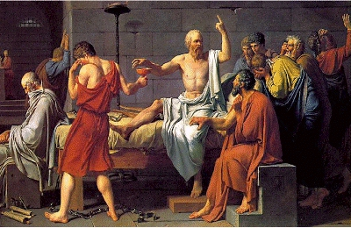
Socrates
Taken to trial (Apology)
Convicted—he did not put on a defense
Sentenced to death
Drank hemlock (Phaedo)

Slide 17
“The unexamined life is not worth living.”
– Socrates

Slide 18
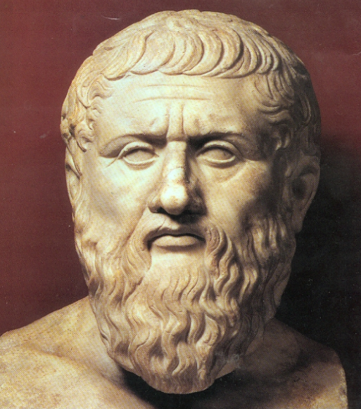
Plato 427-347 BC
Student of Socrates
Born an aristocrat
Founded the Academy
First university
Purpose-thinking about deeper meanings
Wrote dialogues of Socrates, his own political theory and works of ethics

Slide 19
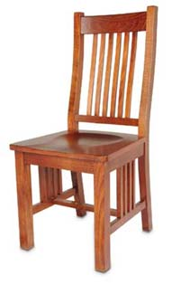
Plato
Forms or Ideas
Continuation of Socrates’ "ultimate nature"
Essence of something lies in the Form
Form has perfection
"Ideals" comes from "Idea" = "Form"
Immaterial things also had Forms
For instance: Our remembrance of the Form of beauty allows us to see beauty in other things

Slide 20
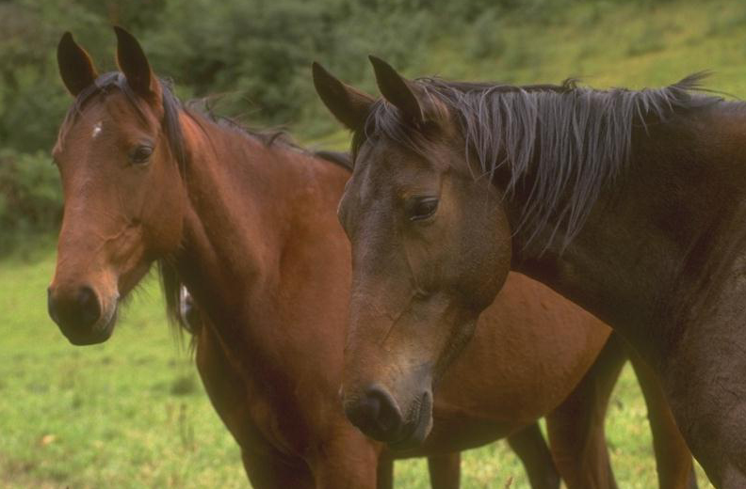
One of Plato’s critics said: “I see particular horses, but not horseness.”
Plato answered: “That is because you have eyes but no intelligence.”

Slide 21
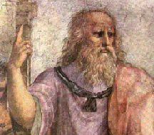
Plato
Spiritual is more real than the physical (Timaeus)
Physical changes, Form is eternal
Truth cannot be perceived by the senses
Perfection is only found in the Forms
At death, the soul migrates to the World of Pure Form
What is the concept of a perfect God?

Slide 22
Plato
The Republic
Idea of the perfect society
“What is the nature of reality?”
Philosophers emerging from the cave

Slide 23
Plato
Mathematics
Supported Pythagorean school
Math is the organizing rules for the Forms which combine in various geometric shapes to create all things
Sign on the door of the Academy
“Let no one ignorant of geometry enter here”

Slide 24
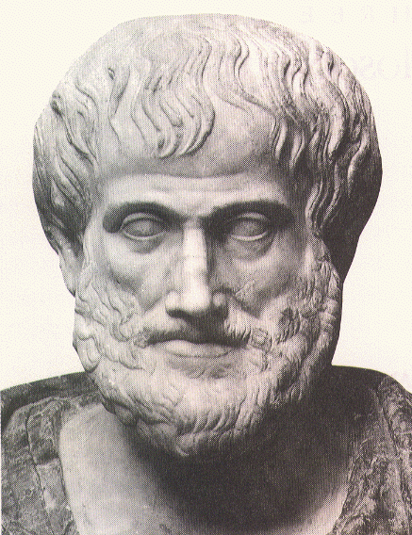
Aristotle 384-322 BC
Son of a physician
Born in Macedonia
Attended the Academy
Became Plato’s foremost student
Left the Academy when Plato died
Founded the Lyceum in Athens
More focused in natural science

Slide 25
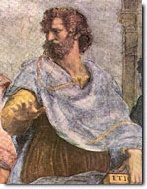
Aristotle
Forms
Some Forms have qualities and quantities that are not fixed (and therefore not "perfect")
Colors or measurements
Forms can be perceived from the object itself by observation and from many others that have similar Forms to develop the nature of the Form of that thing
True nature is understood by observation
Classification of the sciences

Slide 26
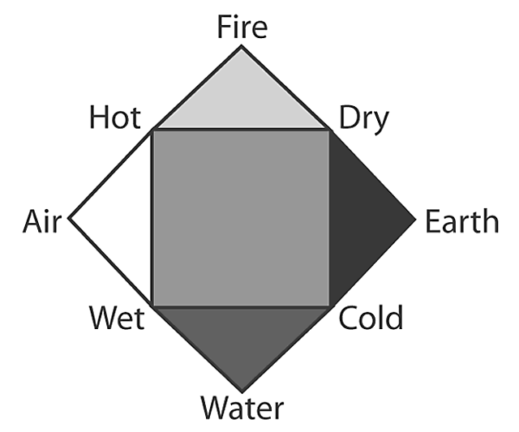
Aristotle
Wrote on physics
Universe is eternal, finite and spherical
Earth is center of the universe
World composed of 4 elements (earth, fire, water, air)
Heavens composed of aether
4 elements affected by qualities (dry, cold, wet, hot)
Real objects are composites of Form and matter
Plato did not value matter
Note Aristotle’s thinking—spirit and body

Slide 27
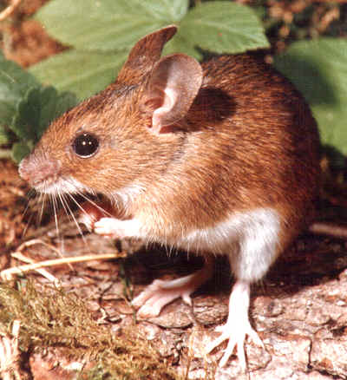
Aristotle
Four Casual Questions (Physics)
Material Question
Efficient Question
Formal Question
Final Question
Example: A Mouse
Is the final cause perfection? Can anything be perfect?

Slide 28
"Nothing we design or make ever really works. We can always say what [more] it ought to do, but that it never does. The aircraft falls out of the sky or rams the earth full tilt and kills the people. It has to be tended like a new born babe... Our dinner table ought to be variable in size and height, removable altogether, impervious to scratches, self-cleaning, and having no legs... Never do we achieve a satisfactory performance."
– Petroski, Henry The Evolution of Useful Things, Vintage Books, 1994, pp. 25.

Slide 29
Aristotle
Developed rules of logic
Syllogism
All trees need light.
An oak is tree.
Therefore, oaks need light.
Inductive
This dog needs lungs, therefore all dogs need lungs
Deductive
All dogs have lungs, therefore this dog has lungs
Aristotle favored deductive reasoning

Slide 30
Aristotle
Wrote on politics
Assembled 158 constitutions to compare
Three type of governments existed
Rule by one man—monarchy/tyranny
Rule by a few men—aristocracy/oligarchy
Rule by many—polity/democracy
Individual considered greater than the state

Slide 31
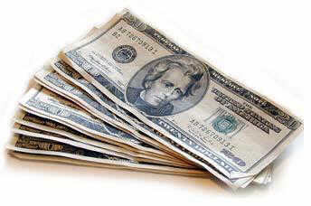
Aristotle
Wrote on ethics
Nicomachean Ethics
Happiness sought after naturally
Three levels of happiness
Based on pleasure
Based on honor
Based on contemplation, philosophy
Advocated the Golden Mean
Money is not the means to happiness

Slide 32
Aristotle
Wrote Rhetoric
Book describing speech to influence others
Ethos—power of persuasion created by the character
Pathos—power of persuasion created by passion
Logos—power of persuasion contained in the speech itself

Slide 33
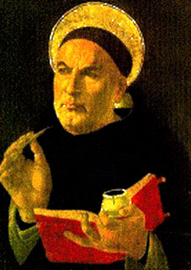
Aristotle' Influence
Taught Alexander the great
Therefore was mistrusted by Athenians
Basis of latter medieval science and religion
Ideas had internal consistency
Ideas were adopted by St. Thomas Aquinas and the Catholic Church

Slide 34
Summary – Greek Legacy on Learning
The world is rational (i.e., science)
The world can be understood by examining the fundamental
Truth is unchanging
Science is available to all
How to learn systematically
Rules of logic

Slide 35
The belief that the universe possesses and is governed according to a comprehensive regulating intelligence, and that this same intelligence is reflected in the human mind, rendering it capable of knowing the cosmic order, was one of the most characteristic and recurring principles in the central tradition of Hellenic thought.
— Tarnas, The Passion of the Western Mind, p 47.

Slide 36
"I cannot but greatly wonder at those who think that we must attend to none but the Greeks as to the most ancient facts, and learn the truth from them only, and that we are not to believe ourselves or other men... Indeed they admit themselves that it is the Egyptians, the Chaldeans and the Phoenicians (for I will not now include ourselves [Jews] among those) that have preserved the memory of the most ancient and lasting tradition. "
– Josephus, (Quoted in Toulmin and Goodfield, The Discovery of Time, The University of Chicago Press, 1965, p. 25.)

Slide 37
Deep Philosophy
From Socrates
“My advice is to get married: if you find a good wife you’ll be happy; if not you’ll become a philosopher.”

Slide 38
Thank You

Slide 39
“The only useful knowledge is that which betters us.”
- Socrates

Slide 40
Plato vs. Aristotle
Particular was less real
Substance is transitory
Form is static
Fear of change
Founded academy
Mystic
Belittler of natural science
Math—highest form of thinking
Universe was less real
Substance needs matter
True nature evolves
Change inevitable to progress
Founded Lyceum
Logician
Observer of natural science
Separated math and science

Slide 41
Platonic vs. Pre-Socratic
World is an ordered cosmos
Pervasive intelligence
Order transcends physical manifestation
Complete knowledge
Full understanding satisfies the mind and soul
Knowledge acquired through reason
Truth is transitory
Natural phenomena are impersonal and physical
Theory measured against empirical knowledge
No thought is final

Slide 42
“Concerning the gods, I have no means of knowing whether they exist or not, nor of what form they are; for there are many obstacles to such knowledge, including the obscurity of the subject and the shortness of human life.”
— Protagoras (a Sophist)

Slide 43
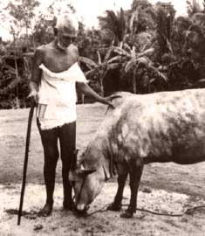
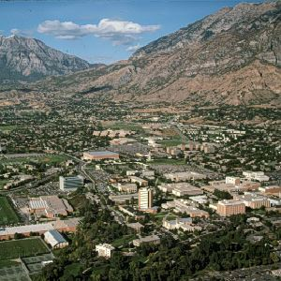
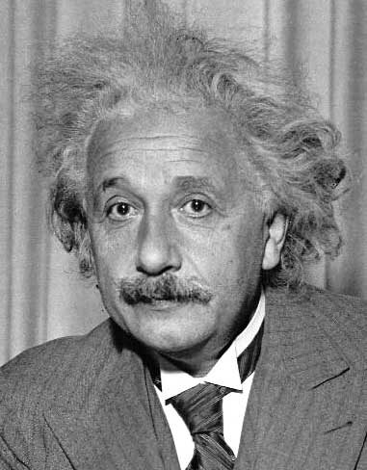
Socrates
Taught a barbarian the Pythagorean Theorem
Knowledge is intuitive and is merely revealed by learning
“Know thyself.” – Socrates
+
=

Slide 44
"[For Plato] knowing is an act of making the observable world intelligible by showing how it is related to an eternal order of intelligible truths.“
– Palmer, Donald, Does the Center Hold?, Mountain View, CA: Mayfield Publishing Company, 1991, p. 58.

Slide 45
"The essence (or 'form,' as he [Aristotle] called it, borrowing Plato's term...) is the thing's 'whatness,' and its materiality is its 'thisness.' That is, an oak tree's 'whatness,' its 'essence' or 'form,' is the combination of characteristics that make it an oak tree rather than, say, a pussy cat; and its 'thisness' is its individuality – what distinguishes this oak tree from all other oak trees."
– Palmer, Donald, Does the Center Hold?, Mountain View, CA: Mayfield Publishing Company, 1991, p. 162-163.

Slide 46
“Aristotle’s universe was composed of a plurality of real beings that fell into an orderly hierarchy of perfection. Prime matter and substantial form were the principles of every physical body. The simplest bodies occurring in nature were the four elements, earth, air, fire and water. These combined to produce the various types of inanimate objects. Living things were more complex bodies which were united by a higher type of substantial form, called soul. Aristotle distinguished three types of souls, vegetative, sensitive, and rational, corresponding to the degrees of perfection found in plants, animals, and human beings.”
— Langford in Galileo, Science and the Church

Slide 47
Socrates
Socratic Method
Posed questions and then questioned the answers
Searched for the ultimate nature of qualities
What is Duty?
What is Truth?
What is Evil?

Slide 48
Socrates taught:
Happiness is the consequence not of physical or external circumstances, of wealth or power or reputation, but of living a life that is good for the soul. Yet to live a genuinely good life, one must know what is the nature and essence of the good.
— Richard Tarnas in The Passion of the Western Mind

Slide 49
"The works of Homer had embodied the aristocratic values that Plato wished to support, but Homer had offered no defense of those values except an appeal to the emotions through his poetic discourse. If Plato was to defend values rationally, he had to replace the power of poetry (as manifested in Greek myth and drama) with that of philosophy, the spokeswoman for reason."
–Palmer, Donald, Does the Center Hold?, Mountain View, CA: Mayfield Publishing Company, 1991, p. 60.

Slide 50
From the Pythagorean perspective, the fundamentals of existence are the archetypal Forms or Ideas, which constitute the intangible substrate of all that is tangible. The true structure of the world is revealed not by the senses, but by the intellect, which in its highest state has direct access to the Ideas governing reality. All knowledge presupposes the abstraction or imaginary metaphor for the concrete world, is here considered to be the very basis of reality, that which determines its order and renders it knowable. To this end, Pythagoras and later Plato declared direct experience of the transcendent Ideas to be the philosopher’s primary goal and ultimate destination.
—Tarnas, The Passion of the Western Mind, p 12.

Slide 51
"[For Plato] the Creation of the cosmos was the process by which the eternal mathematical principles were given material embodiment, imposing an order on the formless raw materials of the world, and setting them working according to ideal specifications... When a mathematician worked out the geometrical relations manifested in the motions of the planets, or the properties of material substances, he was likewise revealing the Craftsman's rational design.“
– Toulmin, Stephen and June Goodfield, The Discovery of Time, The University of Chicago Press, 1965, p.42-43.

Slide 52
"Aristotle believed that the world we are born into is the real world and is not just a shadow of a more ultimate world. He brought Plato's philosophy down to earth by claiming that the Forms must be 'imbedded in matter.' He believed that the distinction between Form and matter was only an intellectual distinction, a distinction that could be drawn in theory but not in reality."
– Palmer, Donald, Does the Center Hold?, Mountain View, CA: Mayfield Publishing Company, 1991, p. 448.

Slide 53
“Good people do not need laws to tell them to act responsibly, while bad people will find a way around the laws.”
Plato

Slide 54
This powerpoint was kindly donated to www.worldofteaching.com
http://www.worldofteaching.com is home to over a thousand powerpoints submitted by teachers. This is a completely free site and requires no registration. Please visit and I hope it will help in your teaching.

